Slide 1


Sadique Ahmad
04 August 2024

Slide 2

Outline
Executive Summary
Introduction
Methodology
Results
Conclusion
Appendix

Slide 3
Executive Summary
Summary of methodologies
Summary of all results

Slide 4
Introduction
Project background and context
Space X advertises Falcon 9 rocket launches on its website with a cost of 62 million dollars; other providers cost upward of 165 million dollars each, much of the savings is because Space X can reuse the first stage. Therefore, if we can determine if the first stage will land, we can determine the cost of a launch. This information can be used if an alternate company wants to bid against space X for a rocket launch. This goal of the project is to create a machine learning pipeline to predict if the first stage will land successfully.
Problems you want to find answers
What factors determine if the rocket will land successfully?
The interaction amongst various features that determine the success rate of a successful landing.
What operating conditions needs to be in place to ensure a successful landing program.

Slide 5

Section 1

Slide 6
Methodology
Executive Summary
Data collection methodology:
Describe how data was collected
Perform data wrangling
Describe how data was processed
Perform exploratory data analysis (EDA) using visualization and SQL
Perform interactive visual analytics using Folium and Plotly Dash
Perform predictive analysis using classification models
How to build, tune, evaluate classification models

Slide 7
Data Collection
The data was collected using various methods
Data collection was done using get request to the SpaceX API.
Next, we decoded the response content as a Json using .json() function call and turn it into a pandas dataframe using .json_normalize().
We then cleaned the data, checked for missing values and fill in missing values where necessary.
In addition, we performed web scraping from Wikipedia for Falcon 9 launch records with BeautifulSoup.
The objective was to extract the launch records as HTML table, parse the table and convert it to a pandas dataframe for future analysis.

Slide 8
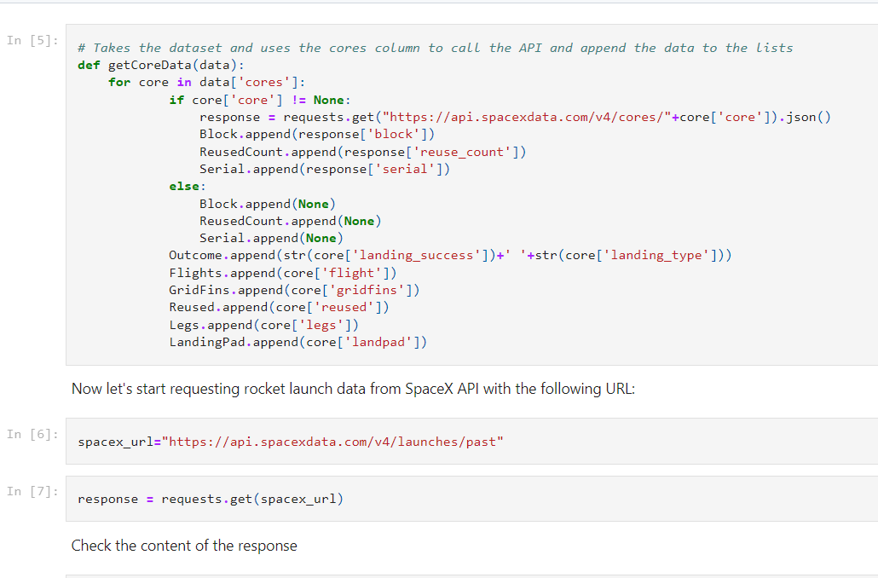
Data Collection – SpaceX API
Present your data collection with SpaceX REST calls using key phrases and flowcharts
Add the GitHub URL of the completed SpaceX API calls notebook (https://github.com/sadiqkhan/testrepo/blob/main/jupyter-labs-spacex-data-collection-api.ipynb), as an external reference and peer-review purpose

Slide 9
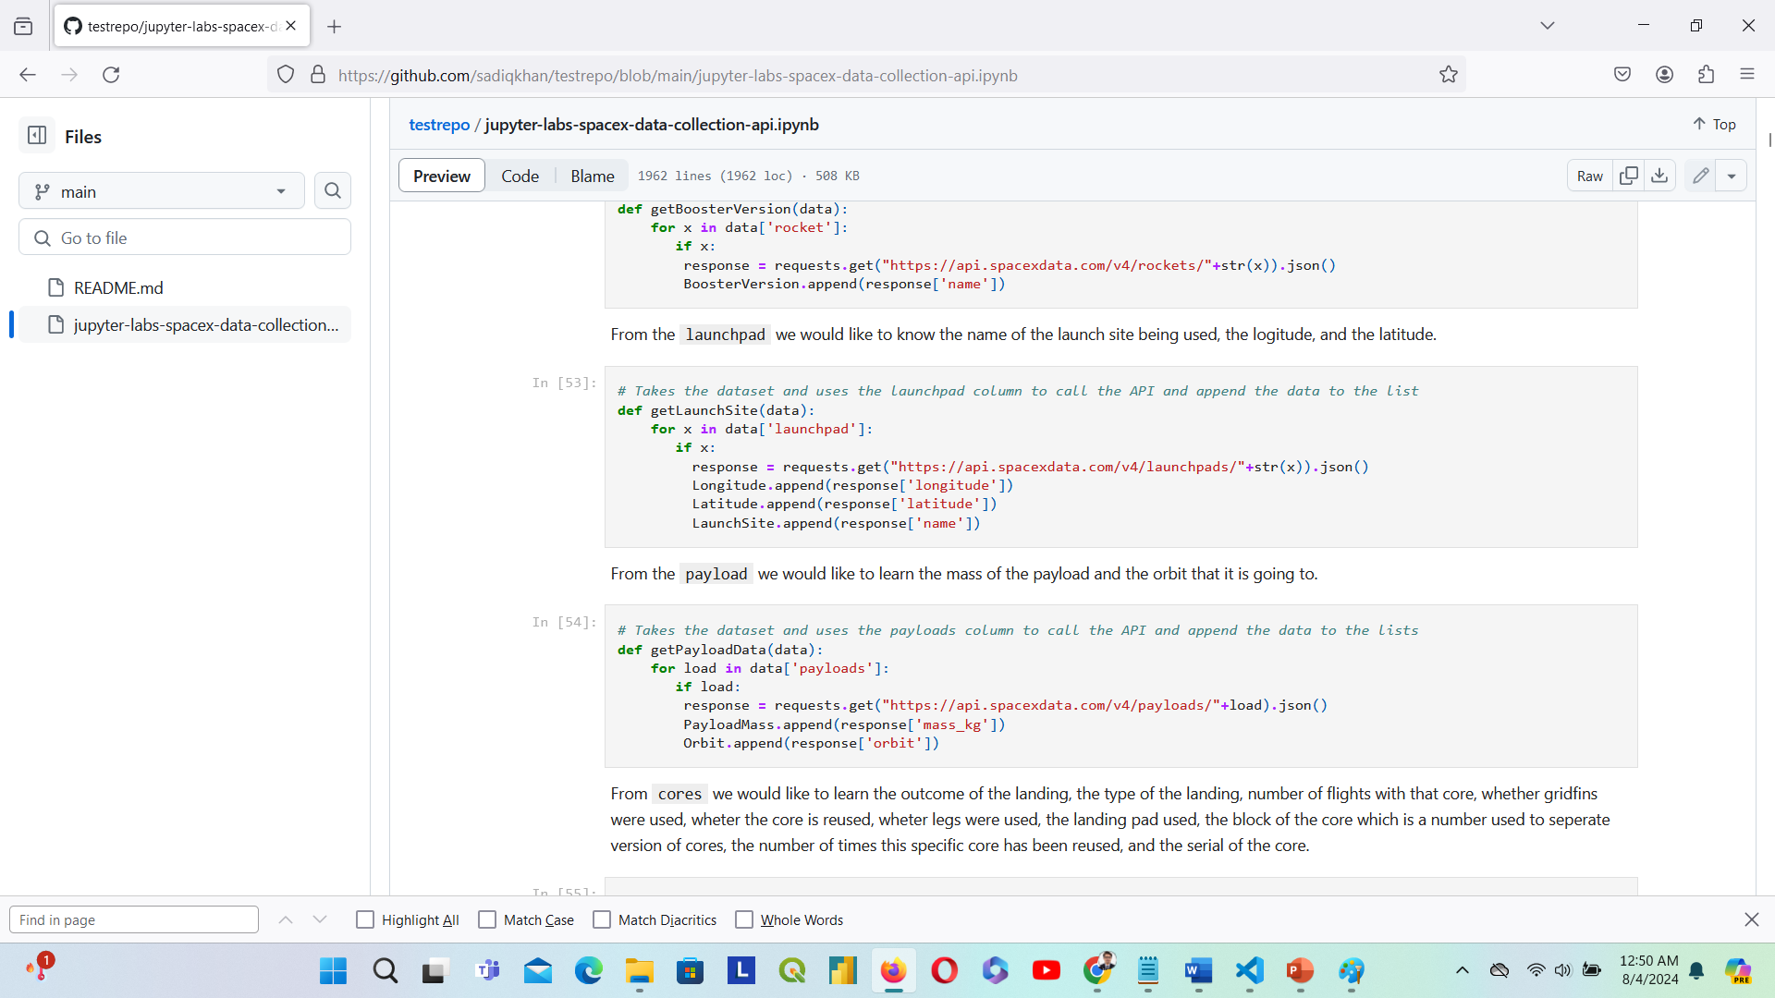
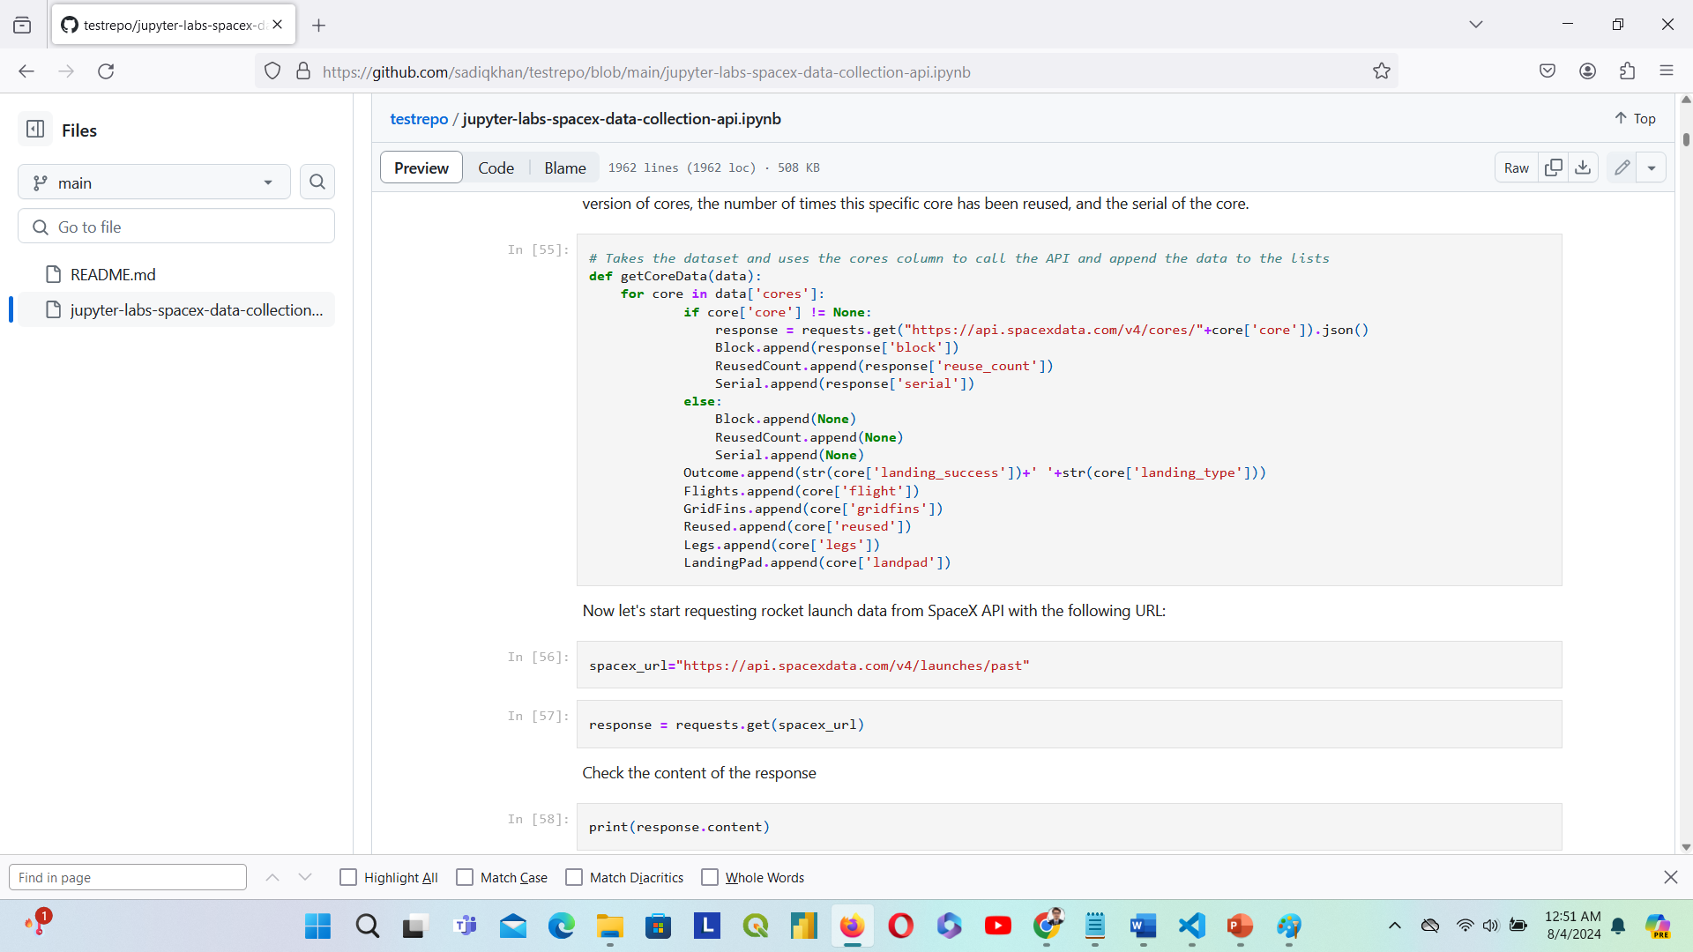

Slide 10
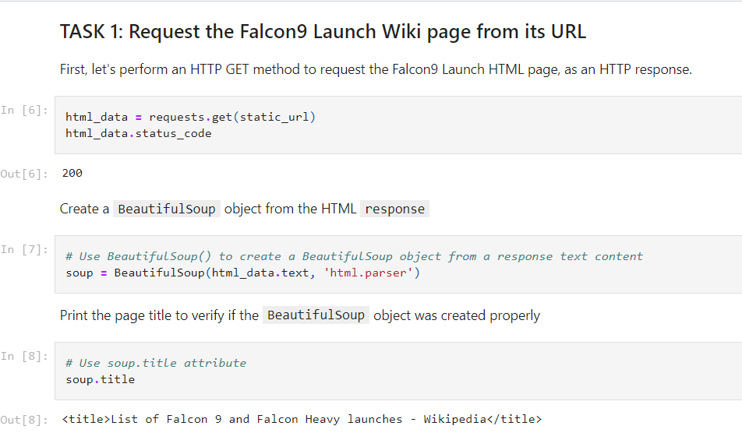
Data Collection - Scraping
Present your web scraping process using key phrases and flowcharts
Add the GitHub URL of the completed web scraping notebook, as an external reference and peer-review purpose. https://github.com/sadiqkhan/testrepo/blob/main/jupyter-labs-webscraping.ipynb

Slide 11
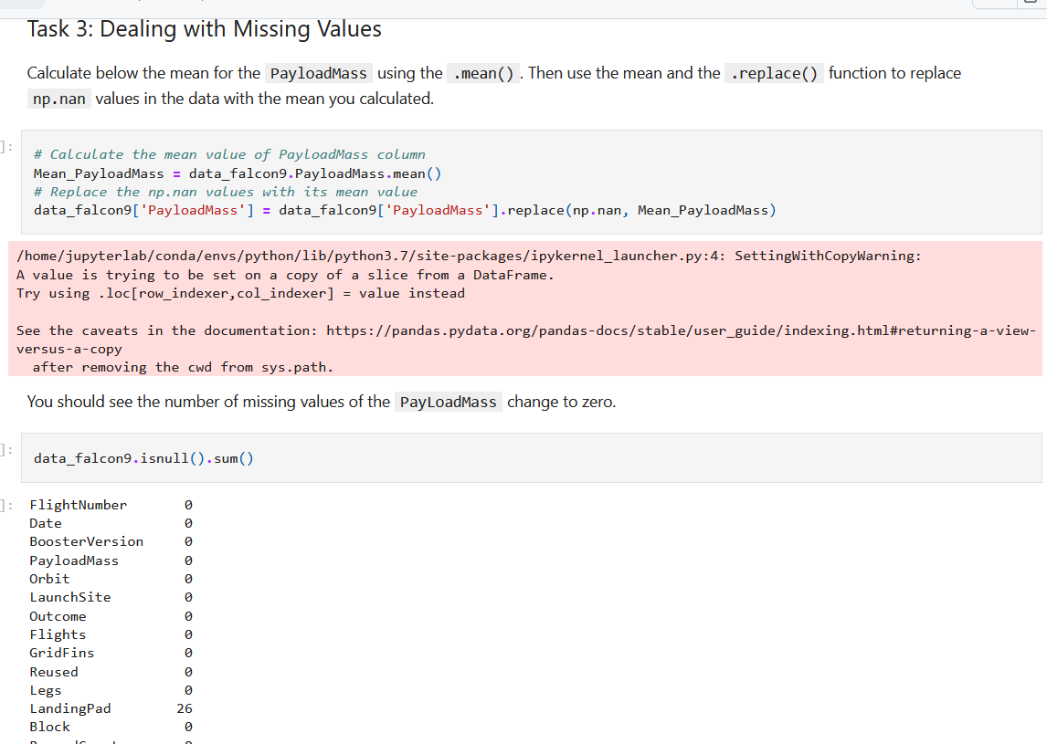
Data Wrangling
https://github.com/sadiqkhan/testrepo/blob/main/jupyter-labs-spacex-data-collection-api.ipynb

Slide 12
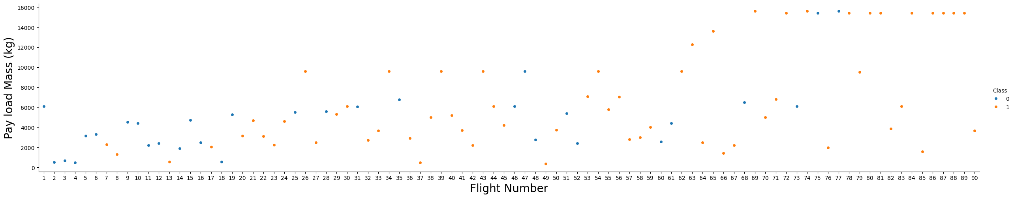
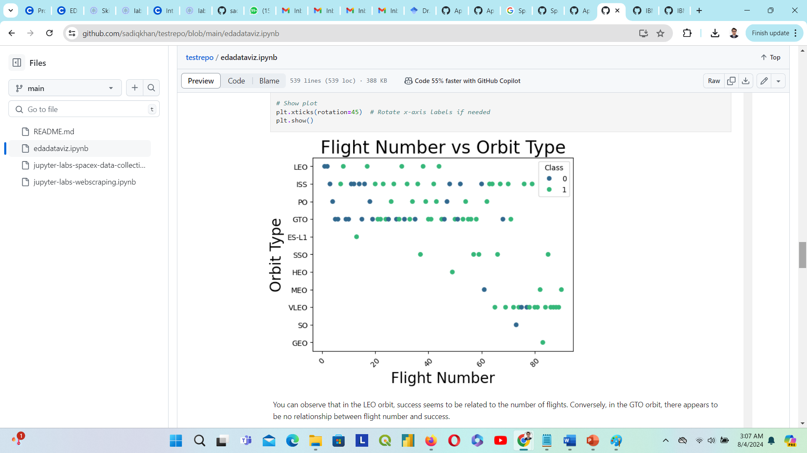
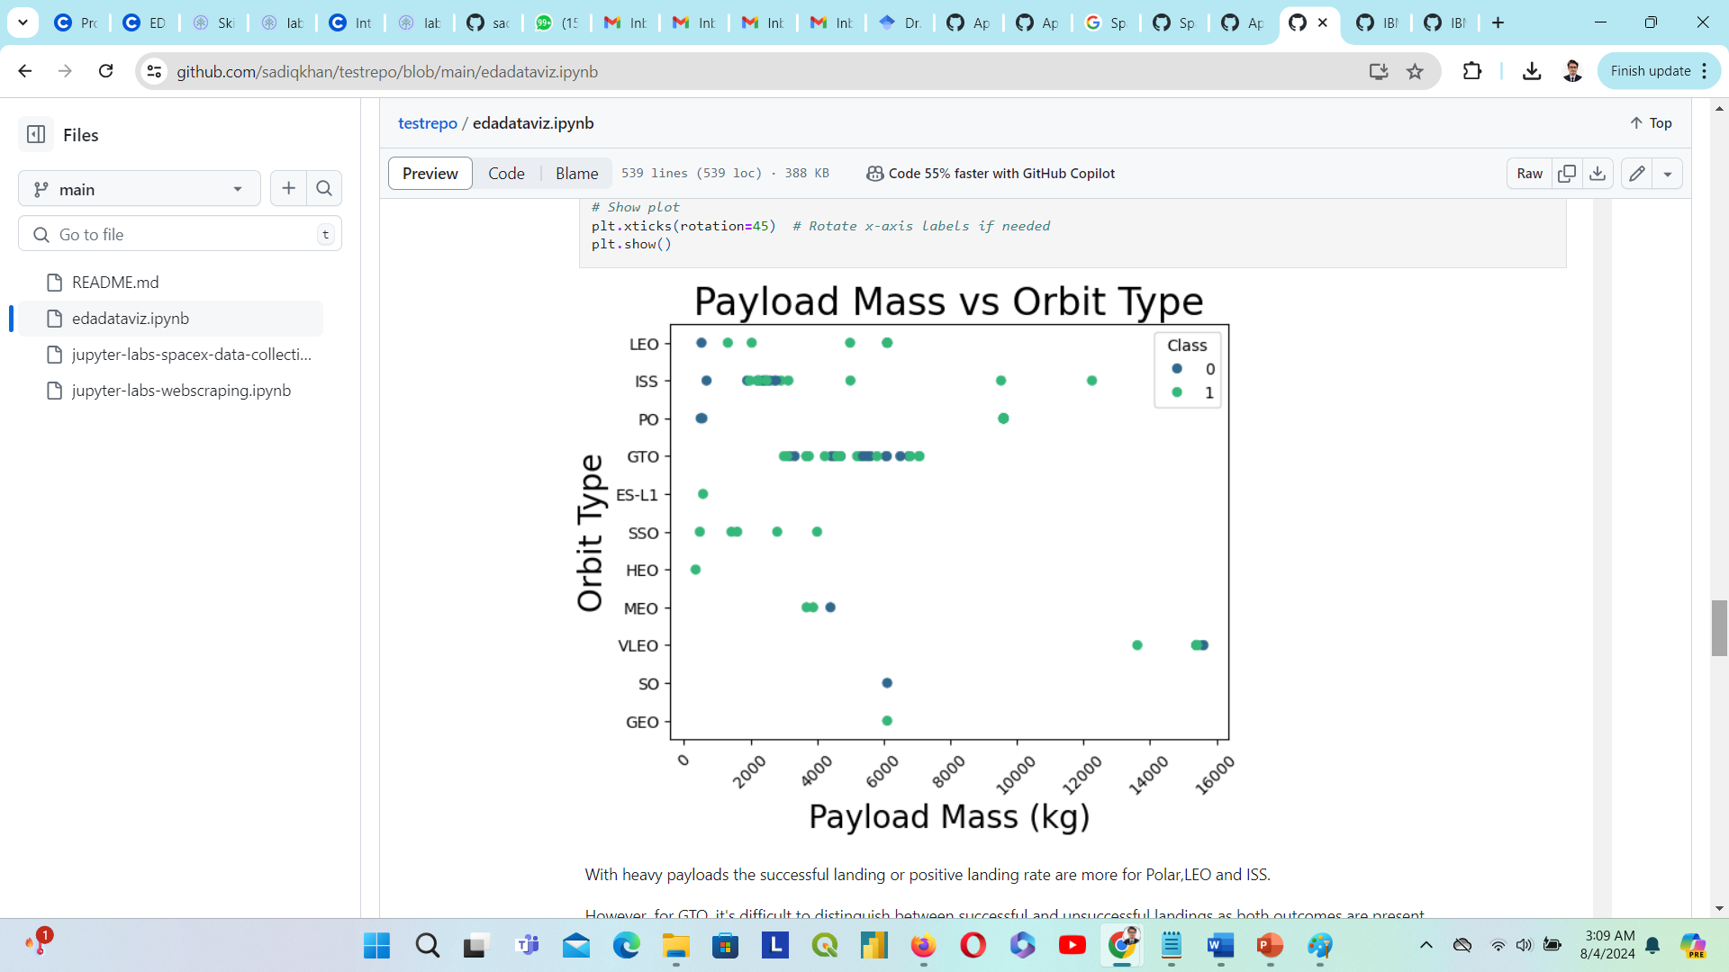
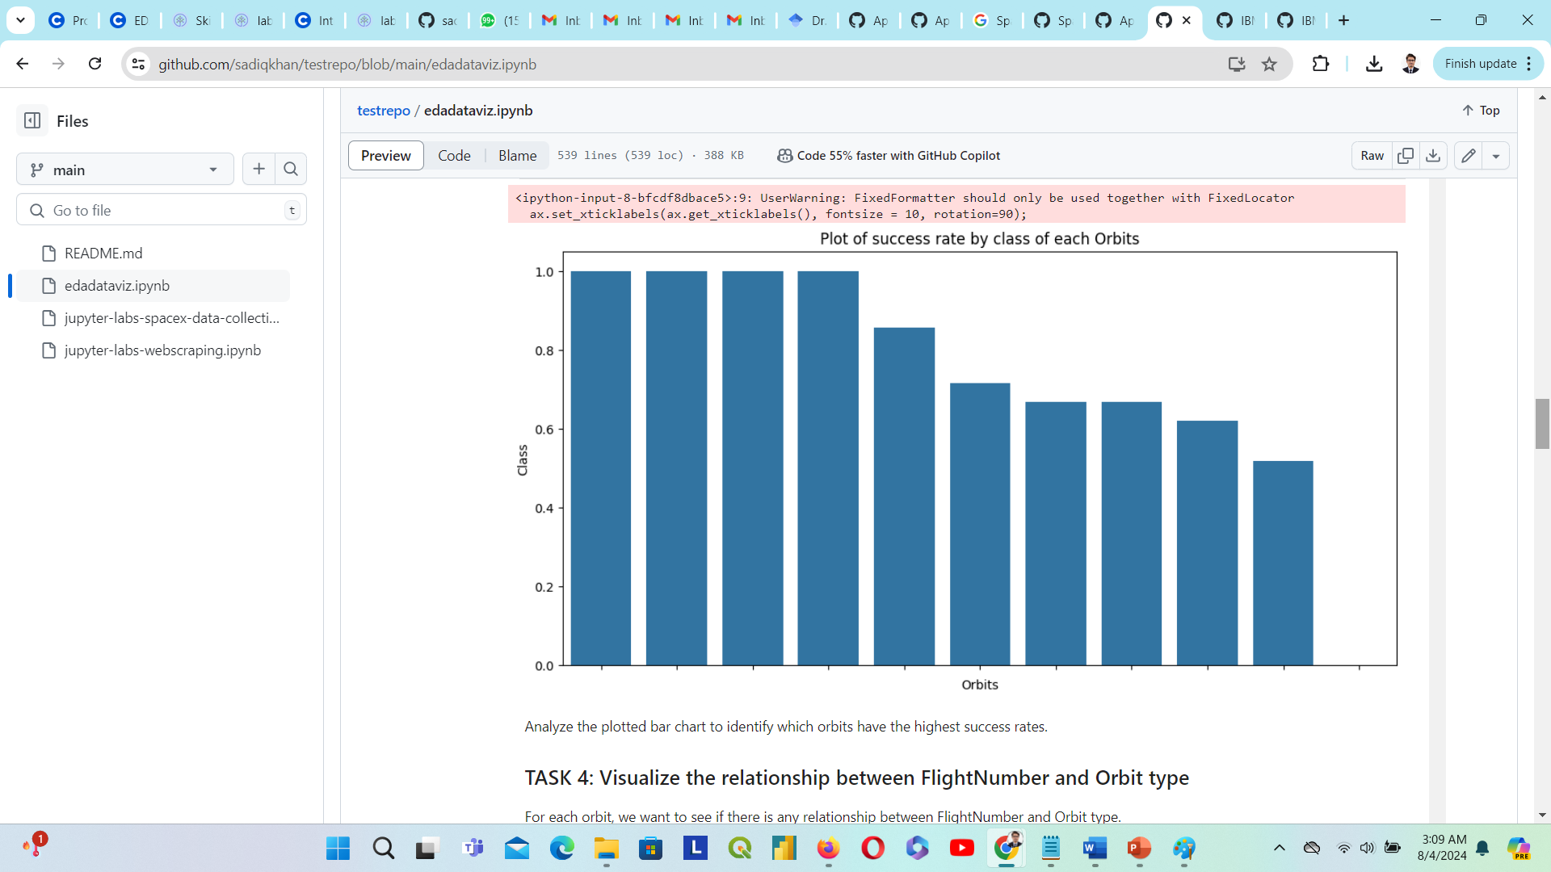
EDA with Data Visualization
During EDA and data visualization, the following charts are achieved. Here is the link for complete code and results. https://github.com/sadiqkhan/testrepo/blob/main/edadataviz.ipynb

Slide 13
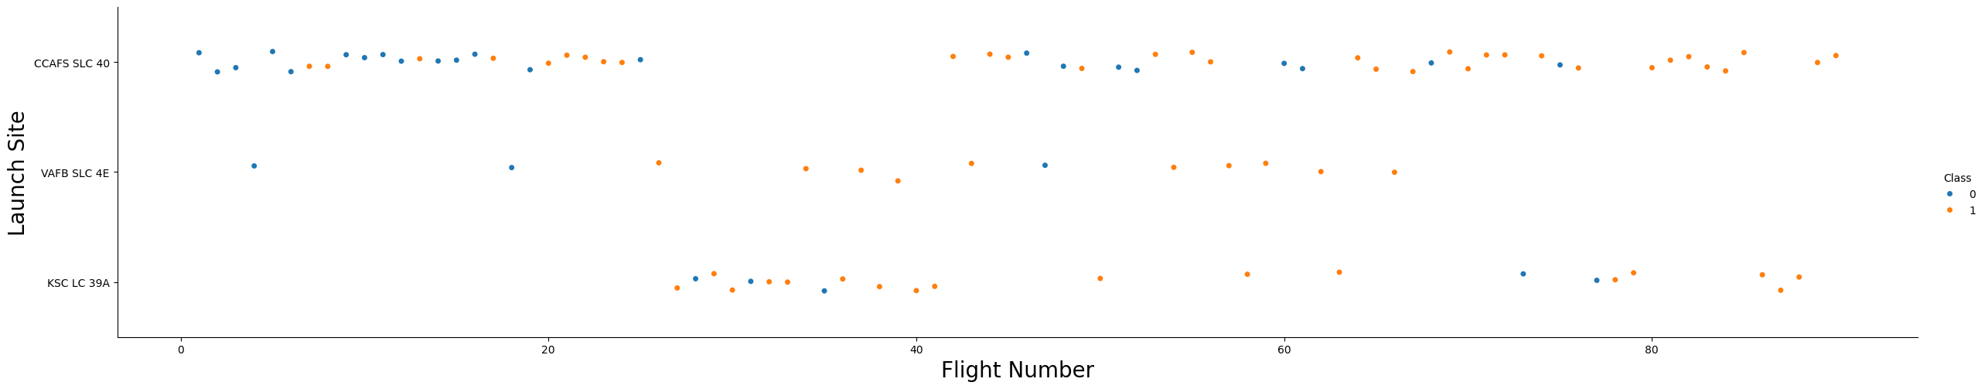
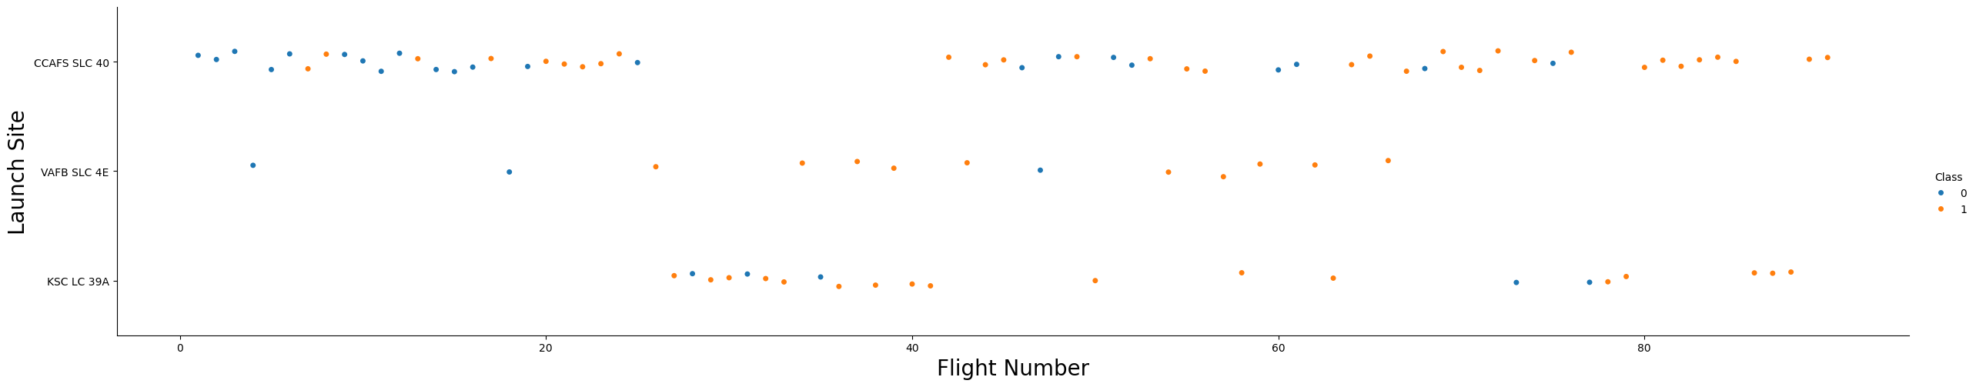
We explored the data by visualizing the relationship between flight number and launch Site, payload, and launch site, the success rate of each orbit type, flight number, and orbit type, and the launch success yearly trend etc.

Slide 14
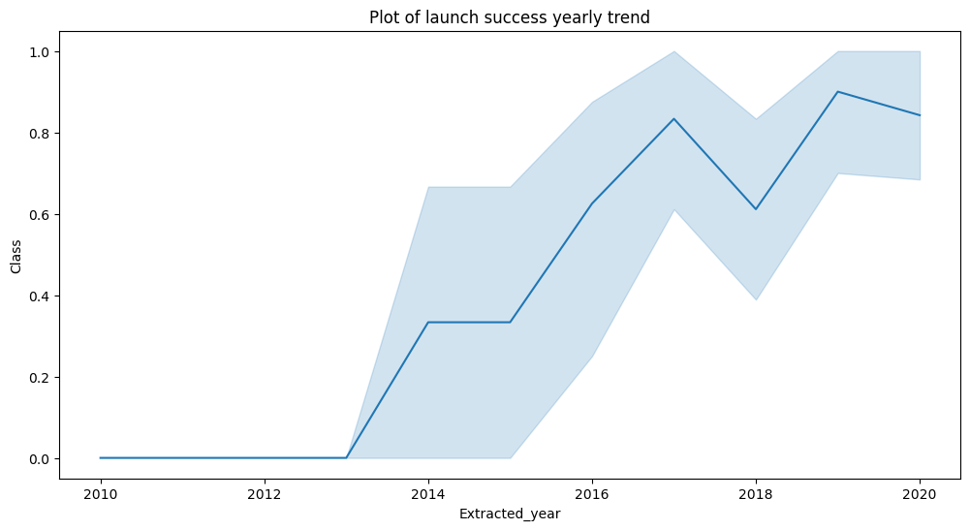

Slide 15
EDA with SQL
Using bullet point format, summarize the SQL queries you performed
%sql SELECT DISTINCT "Launch_Site" FROM SPACEXTABLE;
%sql SELECT * FROM SPACEXTABLE WHERE "Launch_Site" LIKE 'CCA%' LIMIT 5;
%sql SELECT SUM("Payload_Mass") AS Total_Payload_Mass FROM SPACEXTABLE WHERE "Launch_Provider" = 'NASA (CRS)’;
%sql SELECT "Booster_Version" FROM SPACEXTABLE WHERE "Payload_Mass" = (SELECT MAX("Payload_Mass") FROM SPACEXTABLE);
%sql SELECT "Landing_Outcome", COUNT(*) AS Total_Count FROM SPACEXTABLE GROUP BY "Landing_Outcome";
%sql SELECT DISTINCT "Booster_Name" FROM SPACEXTABLE WHERE "Landing_Outcome" = 'Success' AND "Landing_Pad" = 'Drone Ship' AND "Payload_Mass" > 4000 AND "Payload_Mass" < 6000;
%sql SELECT MIN("Date") AS First_Successful_Landing_Date FROM SPACEXTABLE WHERE "Landing_Outcome" = 'Success’;
%sql SELECT AVG("Payload_Mass") AS Average_Payload_Mass FROM SPACEXTABLE WHERE "Booster_Version" = 'F9 v1.1’;
%sql SELECT "Landing_Outcome", COUNT(*) AS Outcome_Count FROM SPACEXTABLE WHERE "Date" BETWEEN '2010-06-04' AND '2017-03-20' GROUP BY "Landing_Outcome" ORDER BY Outcome_Count DESC;
Github: https://github.com/sadiqkhan/testrepo/blob/main/jupyter-labs-eda-sql-coursera_sqllite.ipynb

Slide 16
Build an Interactive Map with Folium
We marked all launch sites, and added map objects such as markers, circles, lines to mark the success or failure of launches for each site on the folium map.
We assigned the feature launch outcomes (failure or success) to class 0 and 1.i.e., 0 for failure, and 1 for success.
Using the color-labeled marker clusters, we identified which launch sites have relatively high success rate.
We calculated the distances between a launch site to its proximities. We answered some question for instance:
Are launch sites near railways, highways and coastlines.
Do launch sites keep certain distance away from cities.
Github: https://github.com/sadiqkhan/testrepo/blob/main/lab_jupyter_launch_site_location.ipynb

Slide 17
Build a Dashboard with Plotly Dash
Github: https://github.com/sadiqkhan/testrepo/blob/main/spacex_dash_app%20(1).py
We built an interactive dashboard with Plotly dash
We plotted pie charts showing the total launches by a certain sites
We plotted scatter graph showing the relationship with Outcome and Payload Mass (Kg) for the different booster version.

Slide 18
Predictive Analysis (Classification)
We loaded the data using numpy and pandas, transformed the data, split our data into training and testing.
We built different machine learning models and tune different hyperparameters using GridSearchCV.
We used accuracy as the metric for our model, improved the model using feature engineering and algorithm tuning.
We found the best performing classification model.
The link to the notebook is https://github.com/sadiqkhan/testrepo/blob/main/SpaceX_Machine%20Learning%20Prediction_Part_5.ipynb

Slide 19
Results
Exploratory data analysis results
Interactive analytics demo in screenshots
Predictive analysis results

Slide 20

Section 2

Slide 21

Flight Number vs. Launch Site
From the plot, we found that the larger the flight amount at a launch site, the greater the success rate at a launch site.

Slide 22


Payload vs. Launch Site

Slide 23
Success Rate vs. Orbit Type
From the plot, we can see that ES-L1, GEO, HEO, SSO, VLEO had the most success rate.

Slide 24

Flight Number vs. Orbit Type
Here LEO orbit, success is related to the number of flights.

Slide 25

Payload vs. Orbit Type

Slide 26

Launch Success Yearly Trend
From the plot, we can observe that success rate since 2013 kept on increasing till 2020.

Slide 27

All Launch Site Names

Slide 28

Launch Site Names Begin with 'CCA'

Slide 29

Total Payload Mass

Slide 30

Average Payload Mass by F9 v1.1

Slide 31

First Successful Ground Landing Date

Slide 32

Successful Drone Ship Landing with Payload between 4000 and 6000

Slide 33

Total Number of Successful and Failure Mission Outcomes

Slide 34

Boosters Carried Maximum Payload

Slide 35

2015 Launch Records

Slide 36

Rank Landing Outcomes Between 2010-06-04 and 2017-03-20

Slide 37

All launch sites global map markers

Slide 38

Markers showing launch sites with color labels

Slide 39

Launch Site distance to landmarks

Slide 40

Pie chart showing the success percentage achieved by each launch site

Slide 41

Pie chart showing the Launch site with the highest launch success ratio

Slide 42

Scatter plot of Payload vs Launch Outcome for all sites, with different payload selected in the range slider

Slide 43

Classification Accuracy
The decision tree classifier is the model with the highest classification accuracy

Slide 44

Confusion Matrix
With the confusion matrix the major problem is the false positives .i.e., unsuccessful landing marked as successful landing by the classifier.

Slide 45
Conclusions
We can conclude that:
The larger the flight amount at a launch site, the greater the success rate at a launch site.
Launch success rate started to increase in 2013 till 2020.
Orbits ES-L1, GEO, HEO, SSO, VLEO had the most success rate.
KSC LC-39A had the most successful launches of any sites.
The Decision tree classifier is the best machine learning algorithm for this task.

Slide 46


